Slide 1

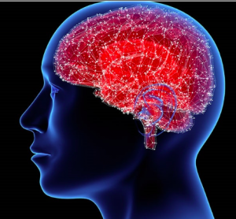
TEAM:-TECH INFINITEX
Parkinson's Disease
Parkinson's disease is a neurodegenerative disorder that affects the dopamine-producing neurons in the brain. It leads to symptoms such as tremors, rigidity, and difficulty with movement.

Slide 2

Table of Contents
Problem Satement
Introduction
Steps involved
Data Preparation
Data Visualization
Outcome
Conclusion
References

Slide 3
Problem Statement:
Parkinson's disease is a neurodegenerative disorder that affects the central nervous system.
It is characterized by the progressive loss of dopamine-producing brain cells, leading to various motor and non-motor symptoms.
The main problem statement for Parkinson's disease can be framed as follows:
"Develop effective strategies for early detection, accurate diagnosis, and personalized treatment of Parkinson's disease to improve the quality of life for patients, slow down disease progression, and eventually find a cure for this debilitating neurological condition."

Slide 4
Introduction to Parkinson's disease:
What is it?
Statistics
Progression
Parkinson's is a neurodegenerative disease that causes dopamine-producing neurons to die in the brain. This leads to symptoms such as tremors, stiffness, and slow movement.
Approximately 10 million people worldwide are living with Parkinson's disease.
Symptoms typically worsen over time, but the rate of progression can vary from person to person.

Slide 5





Steps involved:
1
2
3
4
5
2
5
Get data
Data preparation
Train data
Test data
Prediction analysis

Slide 6
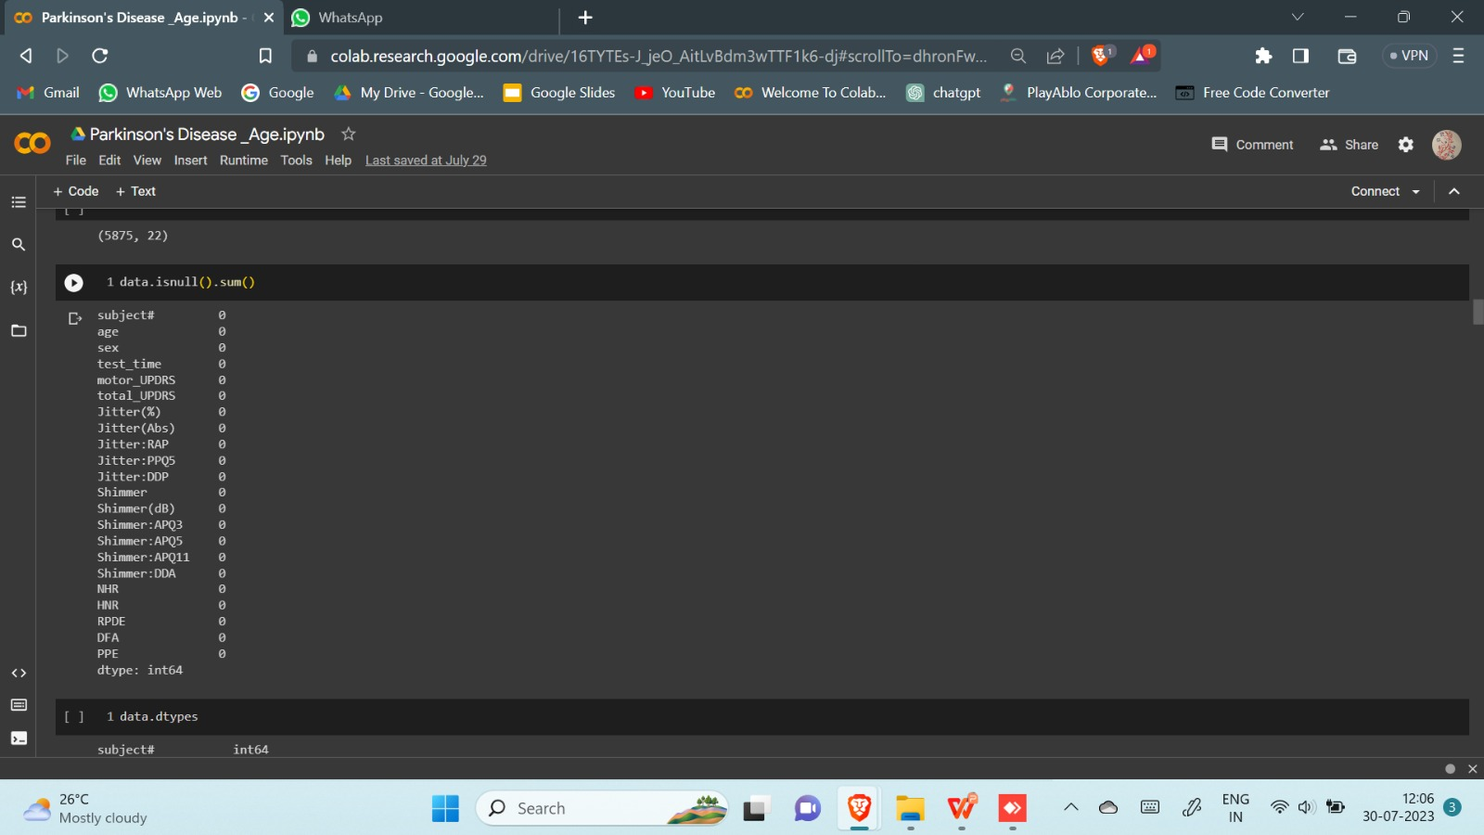
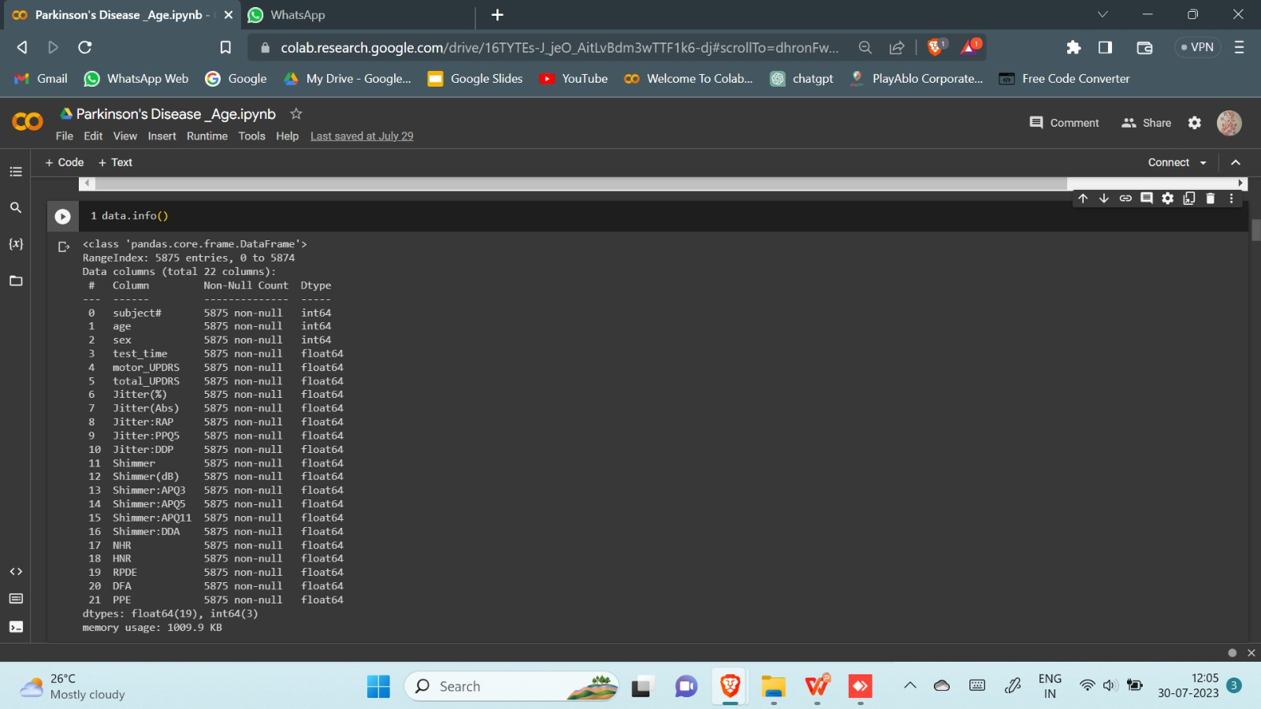
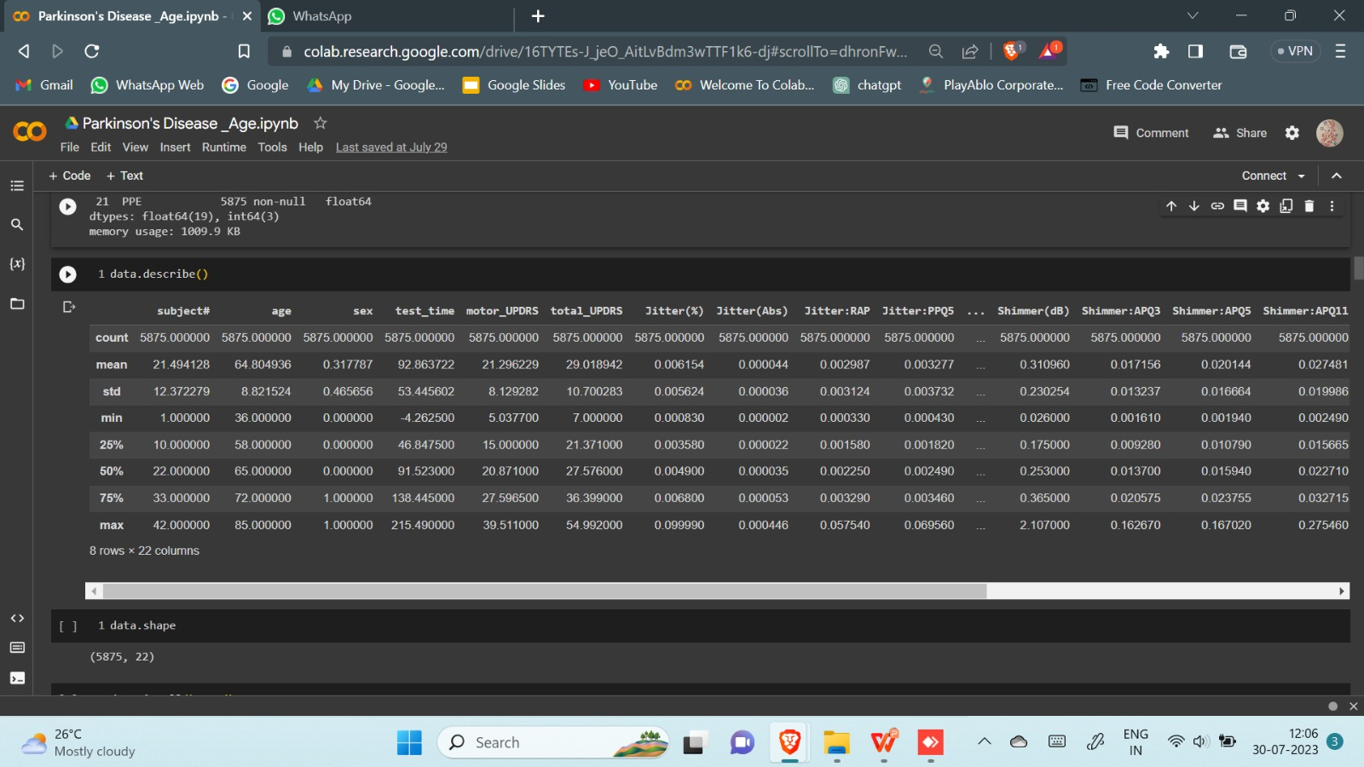
Data Preparation:
Data source collected : https://www.kaggle.com/datasets/thedevastator/unlocking-clues-to-parkinson-s-disease-progressi

Slide 7
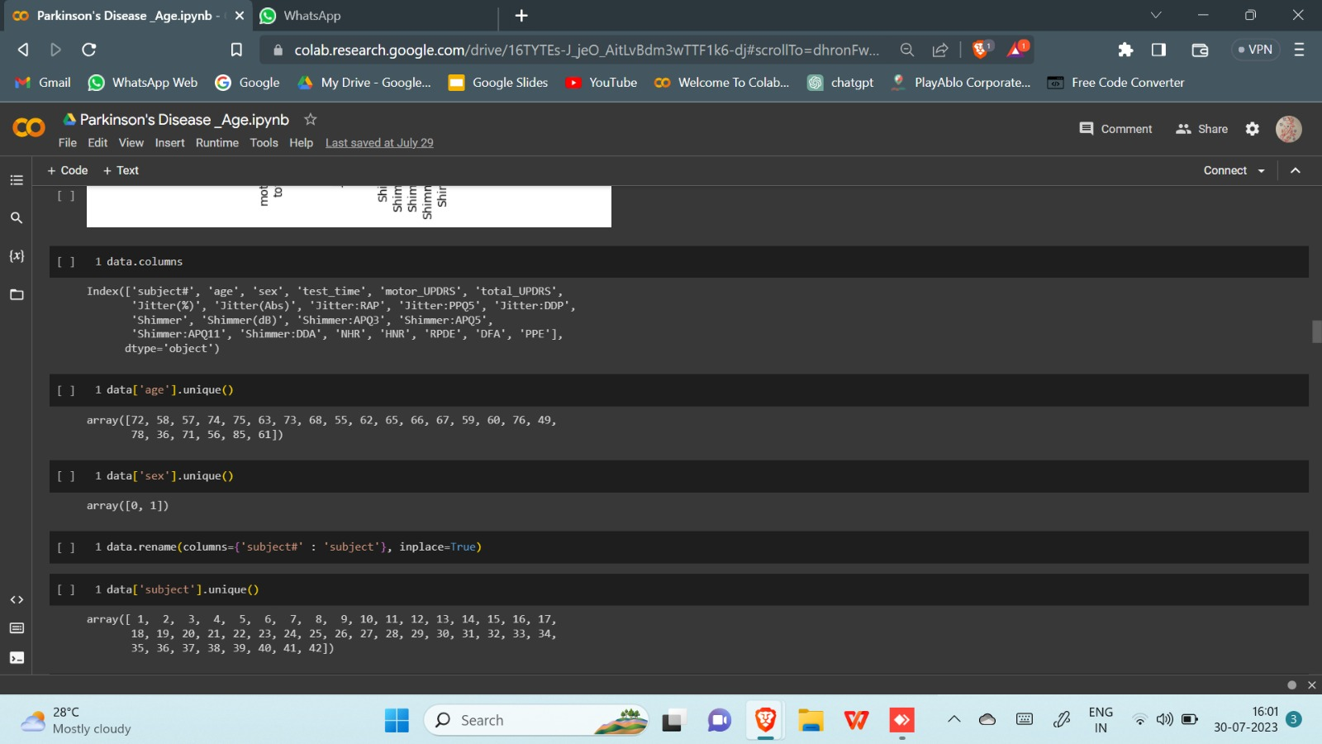
Attributes

Slide 8
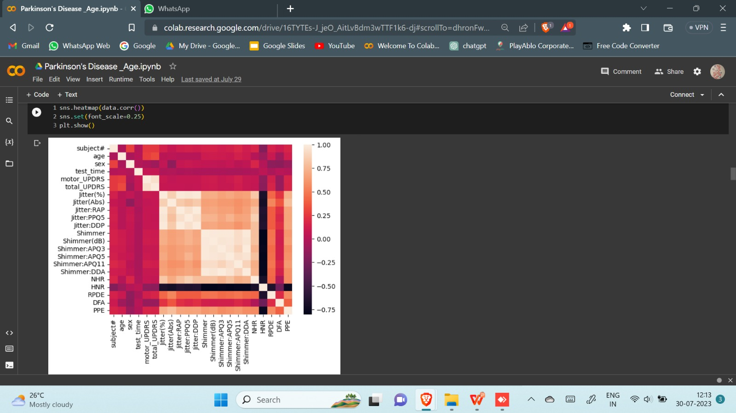
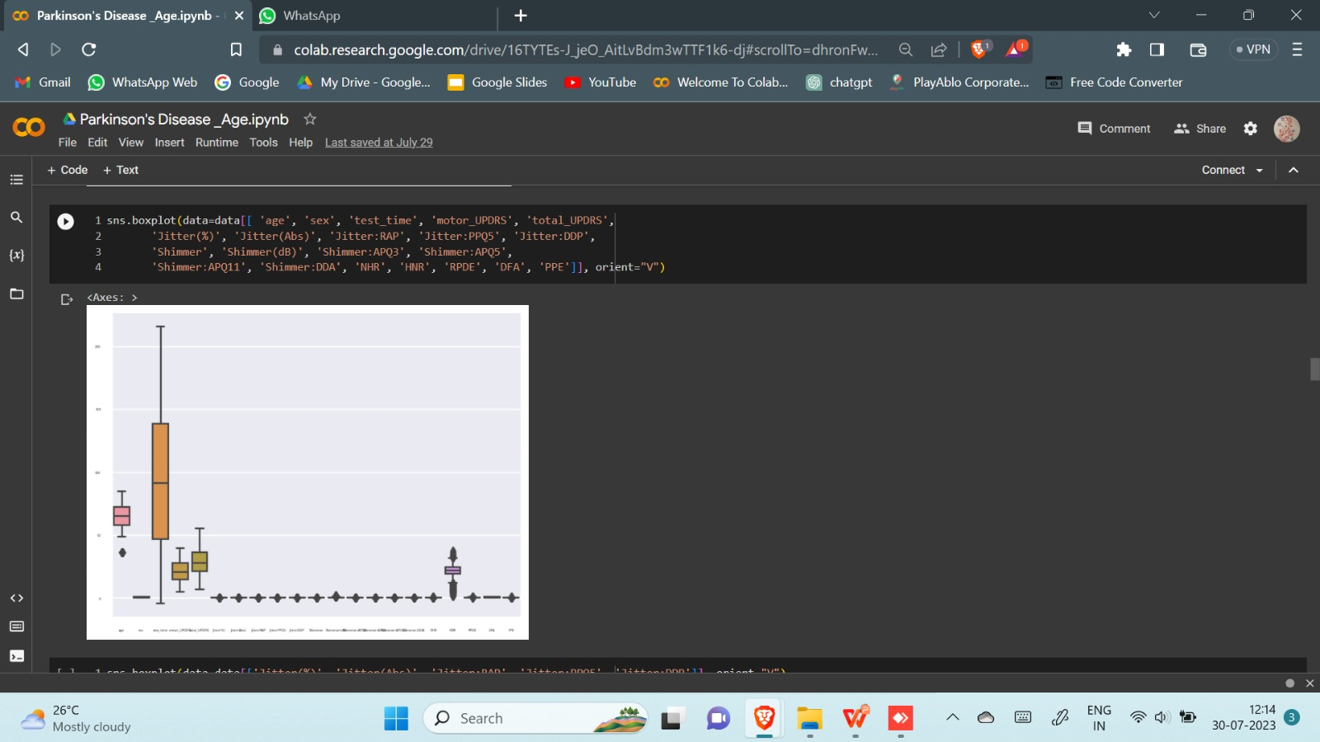
Data Visualization:
Heat map
Box plot

Slide 9
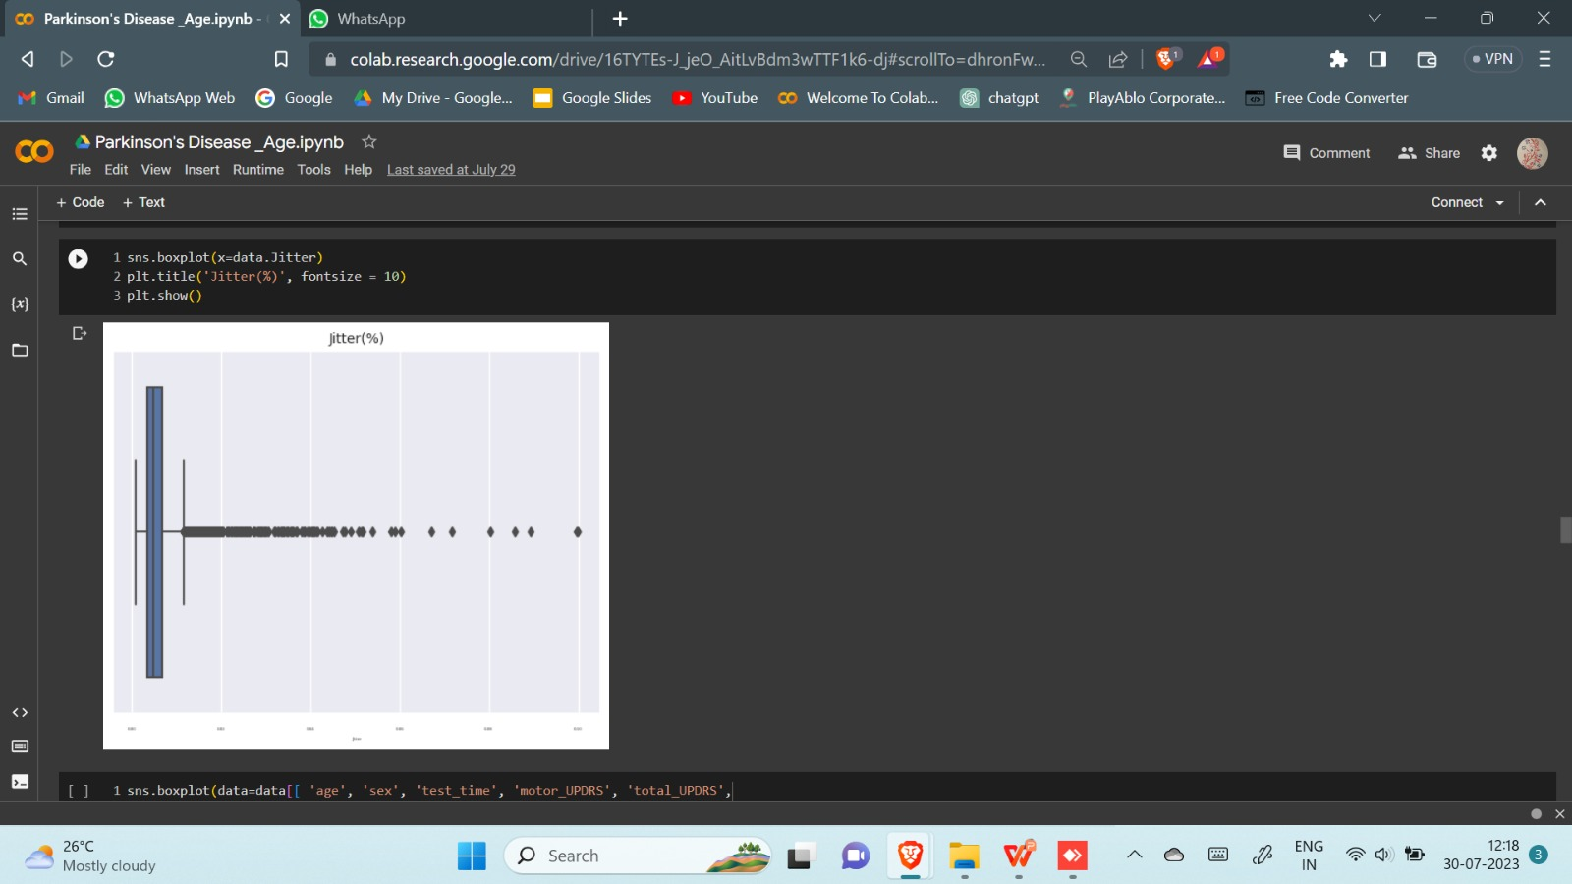
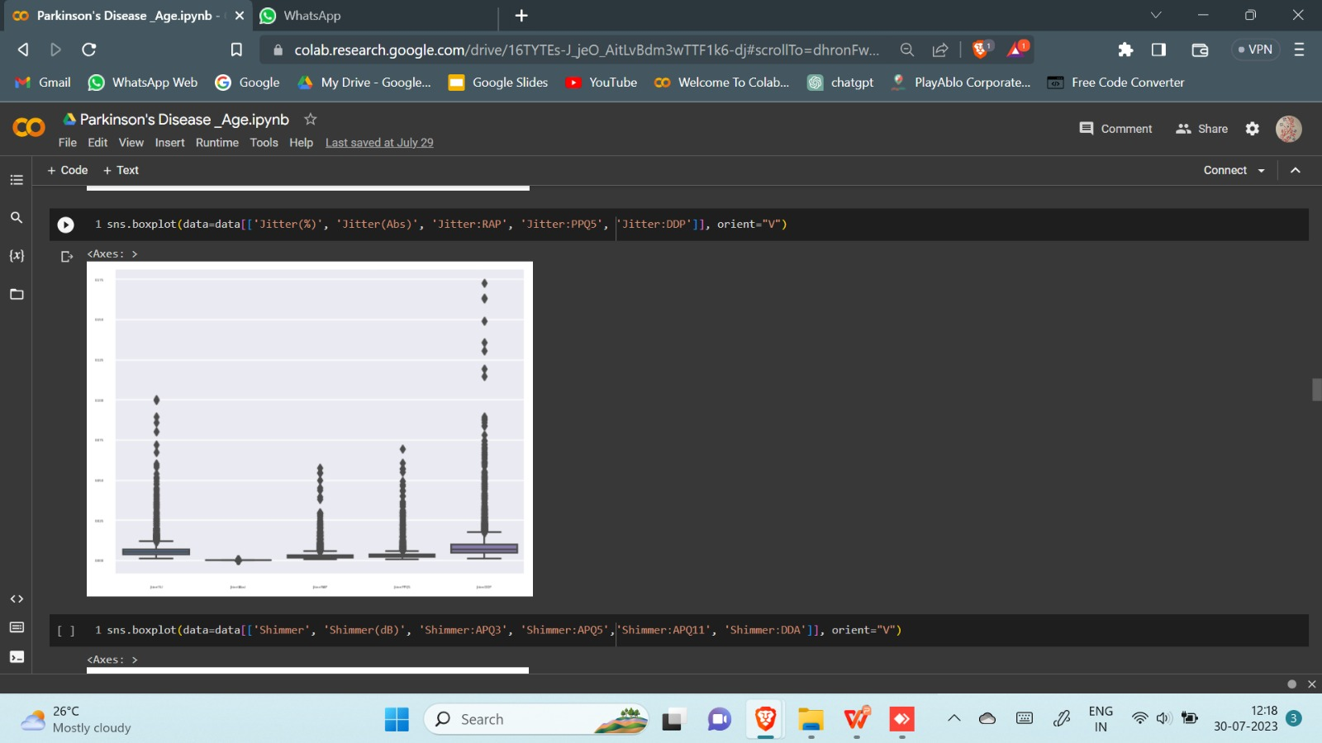
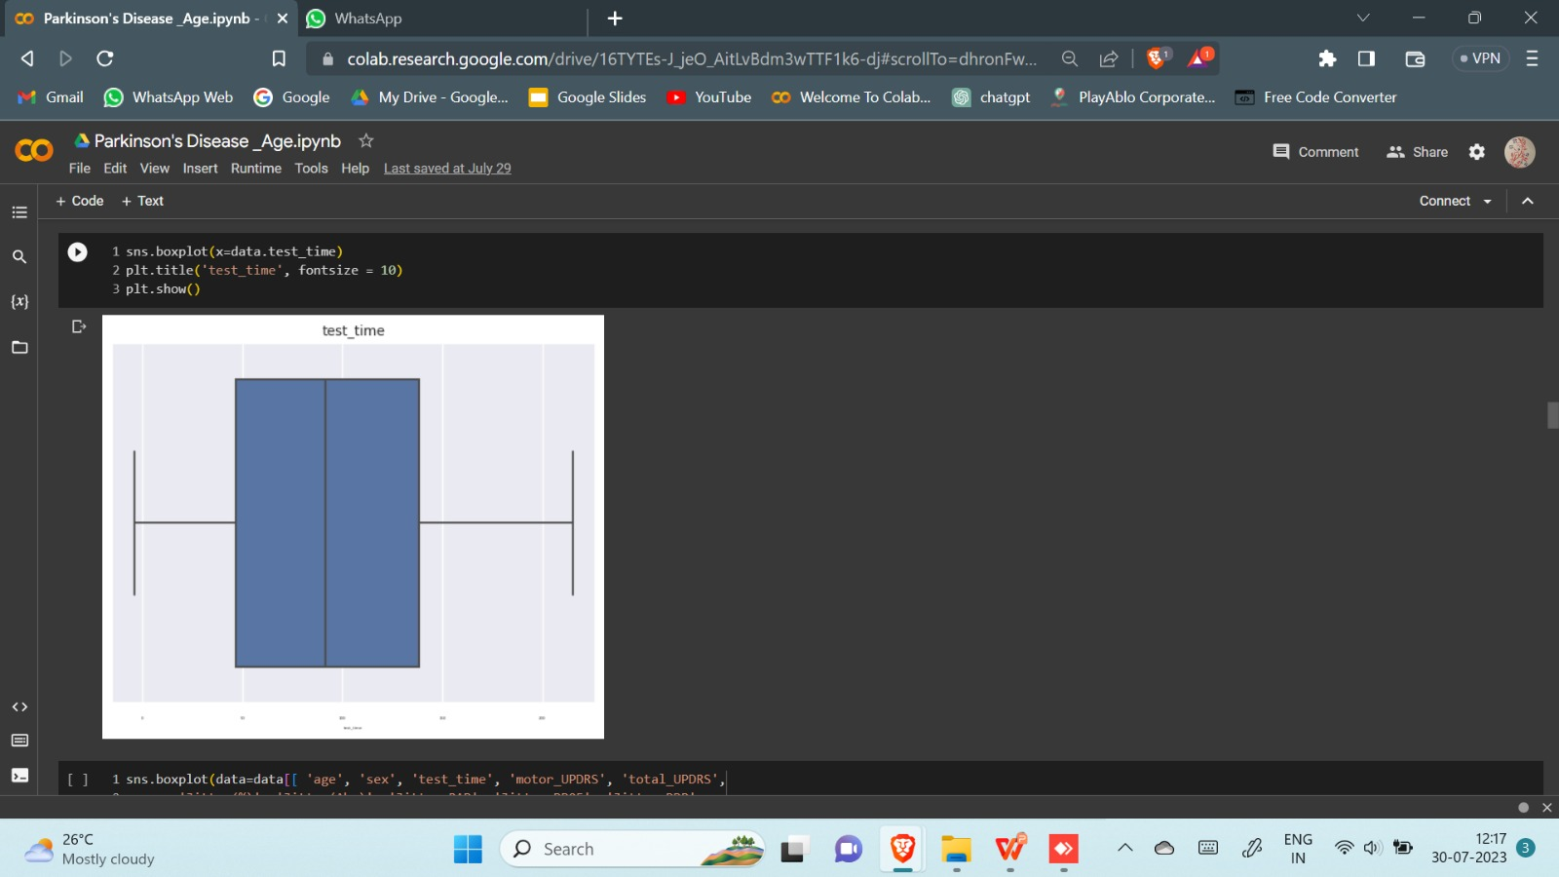
Outliers

Slide 10
1
Training data
Training data refers to the dataset where the model learns from the data patterns and relationships to make predictions or decisions.
Testing data
2
Testing data refers to the dataset that is used to evaluate the performance of a trained machine learning model,in assessing how well the model generalizes to new, unseen data.
3
Predicting data
Its primary purpose is to take input data and produce corresponding output predictions based on the patterns it has learned during training.

Slide 11

Outcome:
Outcome
Our Machine learning therefore have the potential to provide clinicians with additional tools to screen, detect or diagnose PD.
This models can provide the nuclear experts an assistance that can aid them in better and accurate decision making and clinical diagnosis.
Our model predicts gender for a given particular age value as input.
It is also found that the proposed method is fully automated and provides improved performance and hence can be recommended for real life app.

Slide 12


Conclusion
Living with Parkinson's
The Future of Parkinson's
While Parkinson's disease can have a significant impact on a patient's life, taking a proactive approach to managing symptoms and accessing resources can help patients and their caregivers maintain a high quality of life.
Advancements in research and new treatments offer hope for patients with Parkinson's disease, and continuing to fund research is crucial to finding a cure.

Slide 13
References
1
https://in.docworkspace.com/d/sIDvJgbG4AavkmKYG
2
https://www.ncbi.nlm.nih.gov/pmc/articles/PMC10086231/
1
3
https://www.ncbi.nlm.nih.gov/pmc/articles/PMC4517533/

Slide 14

Thank You!!

